Slide 1

A Parallel Algorithm for Constructing Multiple Independent Spanning Trees in Bubble-Sort Networks
Authors: Shih-Shun Kao, Ralf Klasing, Ling-Ju Hung, Chia-Wei Lee, Sun-Yuan Hsieh. Published in the Journal of Parallel and Distributed Computing, 2023. This work proposes a fully parallel algorithm for constructing independent spanning trees in bubble-sort networks, solving an open problem.
By:
Absir Ahmed – 22i0915
Rihab Rabbani – 22i1345
Fahd Ahmad – 22i1131

Slide 2
Background: Bubble-Sort Networks & ISTs
Bubble-Sort Network
Independent Spanning Trees
Vertices: all permutations of {1,2,…,n}
Rooted at identity permutation
Edges: swap adjacent elements
Vertex-disjoint paths for fault tolerance
Connectivity: n-1
Applications: secure message distribution
Diameter: n(n-1)/2

Slide 3
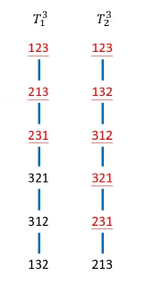
Problem and Motivation
Prior Work
Open Problem
Recursive IST algorithm (Kao et al., 2019), not parallelizable.
Devise a parallel algorithm for ISTs in bubble-sort networks.
Motivation
Enable scalable, fault-tolerant, and secure routing via parallelism.

Slide 4
Proposed Algorithm
Algorithm 1
Computation
Algorithm 1 constructs n-1 ISTs rooted at identity permutation.
Inverse permutation is done in O(n) time.
Non-recursive and fully parallelized.
FindPosition(v) function and Swap(v,u) function
determine the parent in constant time.

Slide 5



Algorithm Overview
Preprocess each vertex to compute inverse permutation set. - For each vertex v != 1_n and three Ttn, apply the reules based on the last symbol v_n to determine the parent
- Use FindPosition and Swap to determine the parent.
2
Case A
(v_n = n)
Handles root connections
Case C
1
(v_n = j)
For j that belongs to {1, 2, …., n-2}, general case
Case B
(v_n = n - 1)
Manages transitions to (n)
3

Slide 6


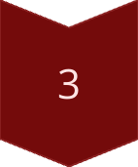
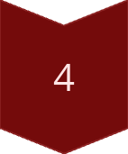
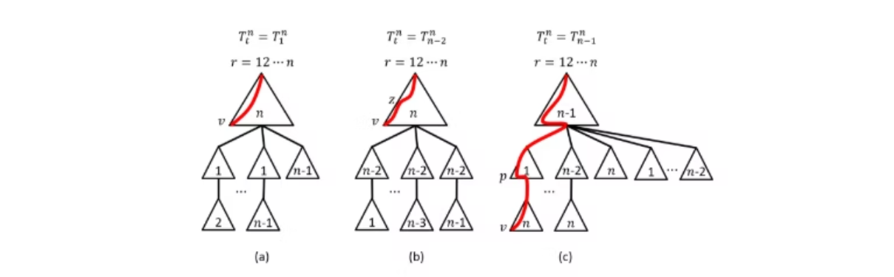
Correctness & Complexity
Correctness
Vertex-Disjoint Paths
Each Tt^n forms a valid spanning tree.
Paths in different trees are vertex-disjoint.
Complexity
IST Height
O(1) per vertex per tree, total O(n·n!).
At most n(n+1)/2 - 1.

Slide 7





Key Contributions
Non-Recursive Algorithm
Optimal Time Complexity
IST Height
At most n(n-1)/2 + n-1.
Total O(n·n!), matches lower bound.
Parent1() computes parent in O(1) time, fully parallelizable.
Correctness
Case analysis ensures vertex-disjoint paths.

Slide 8

Proposed Parallelization Strategy
MPI (Inter-Node)
Partition vertices using METIS, assign to nodes.
OpenMP (Intra-Node)
Threads process vertex-tree pairs independently.
METIS Partitioning
Minimize edge cuts, balance load across nodes.

Slide 9
Practical Implications
Fault Tolerant and Secure Networks
Improve fault tolerance and security
Scalability and Speedup
Scalable due to parallel design and efficient
Energy Efficient
Helps build low-power parallel hardware
Relevance to Project
Implements the concepts of parallel and distributed computing

Slide 10
Conclusion
1
Parallel Algorithm
2
Optimal Time
Presents a parallel, non-recursive algorithm. It constructs 𝑛-1 ISTs in 𝐵𝑛.
Achieves 𝑂(𝑛⋅𝑛!) time complexity. Constant work per vertex.
3
Scalable Parallelism
4
Impactful
Works with MPI, OpenMP, and METIS. Designed for scalable parallelism.
Enhances security and fault tolerance. Solves a key open problem.

